Slide 1
Alexander the Great meets ArcGIS
Another Empire Conquered!
Tama Nunnelley
SS, Computer, Journalism Teacher
Guntersville Middle School, Guntersville, AL
Operations Manager, Alabama Geographic Alliance

Slide 2
About Me
Tama Nunnelley
6th-8th Grade SS at Guntersville Middle School, Guntersville, Alabama
Alabama Geographic Alliance, National Council Geographic Education, Social Studies Council of Alabama, National Council for Social Studies
Distinguished Geography Teacher- NCGE 2015
National Geographic Certified Educator- NG October 2015
Geography Awareness Week Coordinator

Slide 3
Background
Alabama Geographic Alliance Technology workshop
Special needs classroom
Incorporation of ELA into SS and CCRS
History meets Nonfiction, low level, reading
History came alive. It became visual

Slide 4
It started with a book!
http://www.salariya.com/wouldnt/pages/wouldnt.html
Notes:
brief walk through

Slide 5
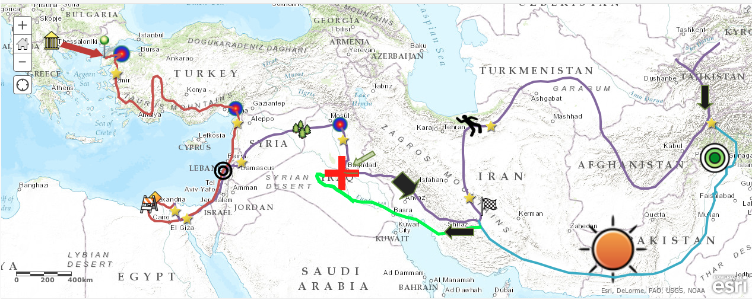
It became a map!
http://www.arcgis.com/home/webmap/viewer.html?webmap=6b85e9e73ad6434d937fd197b2c11b65
Notes:
brief walk through

Slide 6
And, the map became a learning tool!
Notes:
brief walk through

Slide 7
What was achieved?
Students:
Reading a map/Making a map
Understanding of historical data.
Visualization of historical data.
Primary and secondary source analysis.
Interpretation and representation.
Research, collection, analysis, and citation of sources.
Vital college and career skills.
Collaboration.
Future Students:
All of previous achievements.
Compare and Contrast changes and developments in historical evidence.
Cartographical thinking.
Modeling of critical learning techniques.
Connection to database of resources.
Higher order thinking.

Slide 8
How can you use GIS in your classroom?
ArcGIS
(ESRI)
Free online mapping tools and activities for your school.
“A variety of subject-focused, standards-based instructional materials is available to enhance inquiry-based learning with students. All activities are free and completely online.” They are offered through the ConnectEd Initiative.
Mapmaker Interactive
(National Geographic)
“A new feature on the MapMaker Interactive gives you the ability to create your own set of bookmarks, or a geotour, that you can save and share with the world.”

Slide 9
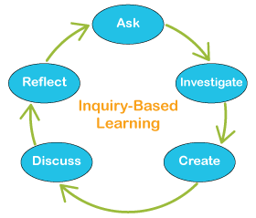
ArcGIS Online Instructional Activities
Inquiry with Maps
Gallery Maps
Story Maps

Slide 10
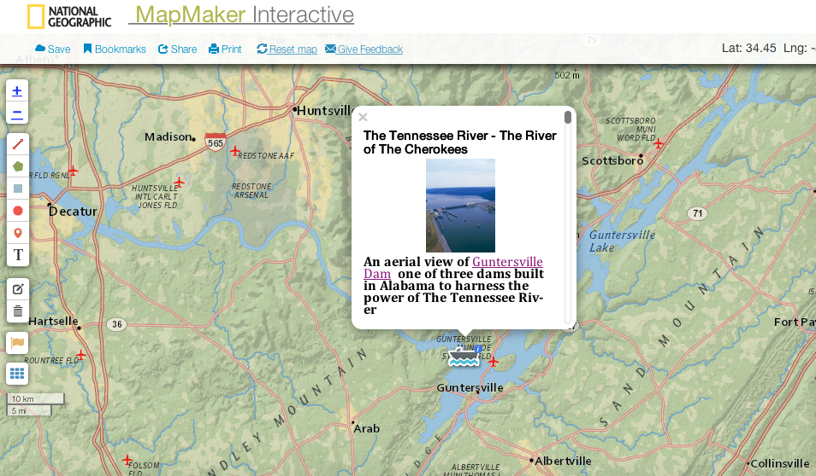
MapMaker Interactive
GeoStories
Geo Tours
MapMaker Kits
Tutorials and Activities

Slide 11
Sample Plans
Sample Lesson from Minnesota Social Studies Council
5 Easy Lesson from ArcGIS

Slide 12
A Final Note
Explore! The Power of maps: Geography Awareness Week Begins!
Ideas/Questions
Contact Me:
tamanunnelley22@gmail.com

